Slide 1

Zenith Hackathon 5.0
AltScore
Making Credit Access Fair for everyone
Team Name : TECH CRUSADERS
Team Members : Nithilan S
Muskan Kumari V
Charumadhi M
Department : Information Technology

Slide 2
Problem Statement – “Why Traditional Credit Scoring Fails Millions”
Imagine you're 25 years old. You've been responsibly paying your rent, utilities, and phone bills for years. You've never missed a payment. But when you walk into a bank for a small loan, they say no.
Why? Because you have no “credit history”.
This affects 1.7 billion people globally.
The traditional system looks for:
Previous loans (which you don't have)
Credit cards (which you couldn't get without credit history)
Collateral (which young people rarely have)
Our Solution: Build a credit scoring system that uses different data:
• Your transaction history (how you spend money)
• Your utility bill payments (do you pay on time?)
• Social indicators (where you live, your community)

Slide 3
Our Solution + The Data – “How We're Doing It (and What Data We Have)”
Instead of asking "Do you have credit history?“
We ask:
Do you pay your bills on time?
Are you consistent with payments?
What's your life context - age, education, where you live?
The Dataset That Makes This Possible:
Main data:
307,511 real loan applications with outcomes (who repaid, who defaulted)
We know exactly what happened - perfect for machine learning
What We Have | What It Shows | Records
POS/Cash Payments | Regular payment behavior (like utility bills) | 10.0 million
Installment History | When do people actually pay? Early? Late? | 13.6 million
Bureau Records | Credit relationships with other banks | 1.7 million
Previous Applications | Past loan attempt patterns | 1.7 million
Credit Card Behavior | How they use credit when they have it | 3.8 million
Total: 58.4 million data points to learn from!

Slide 4
What we’ve done - EDA
Understanding the Data
Loaded all 307,511 apps + 58M records
Finding Patterns
Created 10 professional visualizations
Generating Insights
Identified top predictive features
Profiled data quality - found missing values, understood distributions
Mapped relationships between 7 different data tables
Identified our target: 8.07% default rate (24,825 defaults)
Analysed patterns across:
Ran statistical tests to validate findings
Validated that alternative data actually works
Found key patterns that will drive our model
Documented everything (12 detailed reports)
Demographics (age, education, gender)
Financial behavior (income, credit, leverage)
Payment behavior (timing, regularity, amounts)
Geographic factors (region, housing, employment)

Slide 5
Inference 1 – Alternative Data Works
The Experiment: We split all 307,511 applications into groups based on what alternative data was available:
Data Available | Count | Default Rate | Risk Level
NO alternative data | 2,470 (0.8%) | 7.25% | 🔴 Baseline
Only bureau history | 13,984 (4.6%) | 5.72% | 🟢 21% LOWER!
Only previous apps | 41,550 (13.5%) | 10.16% | 🔴 Higher
Both sources | 249,507 (81.1%) | 7.84% | 🟡 Moderate
What This Tells Us:
✅ Alternative data reduces default risk by 21% (from 7.25% to 5.72%)
✅ Quality matters more than quantity - bureau data alone is better than just previous apps
✅ Our approach is validated - alternative data sources DO predict creditworthiness
The Business Case:
Traditional banks reject those 2,470 people with no data (0.8% of population)
Our model will serve them using different signals - payment behavior, geographic context, life stage
We can help the underbanked while maintaining good risk management

Slide 6
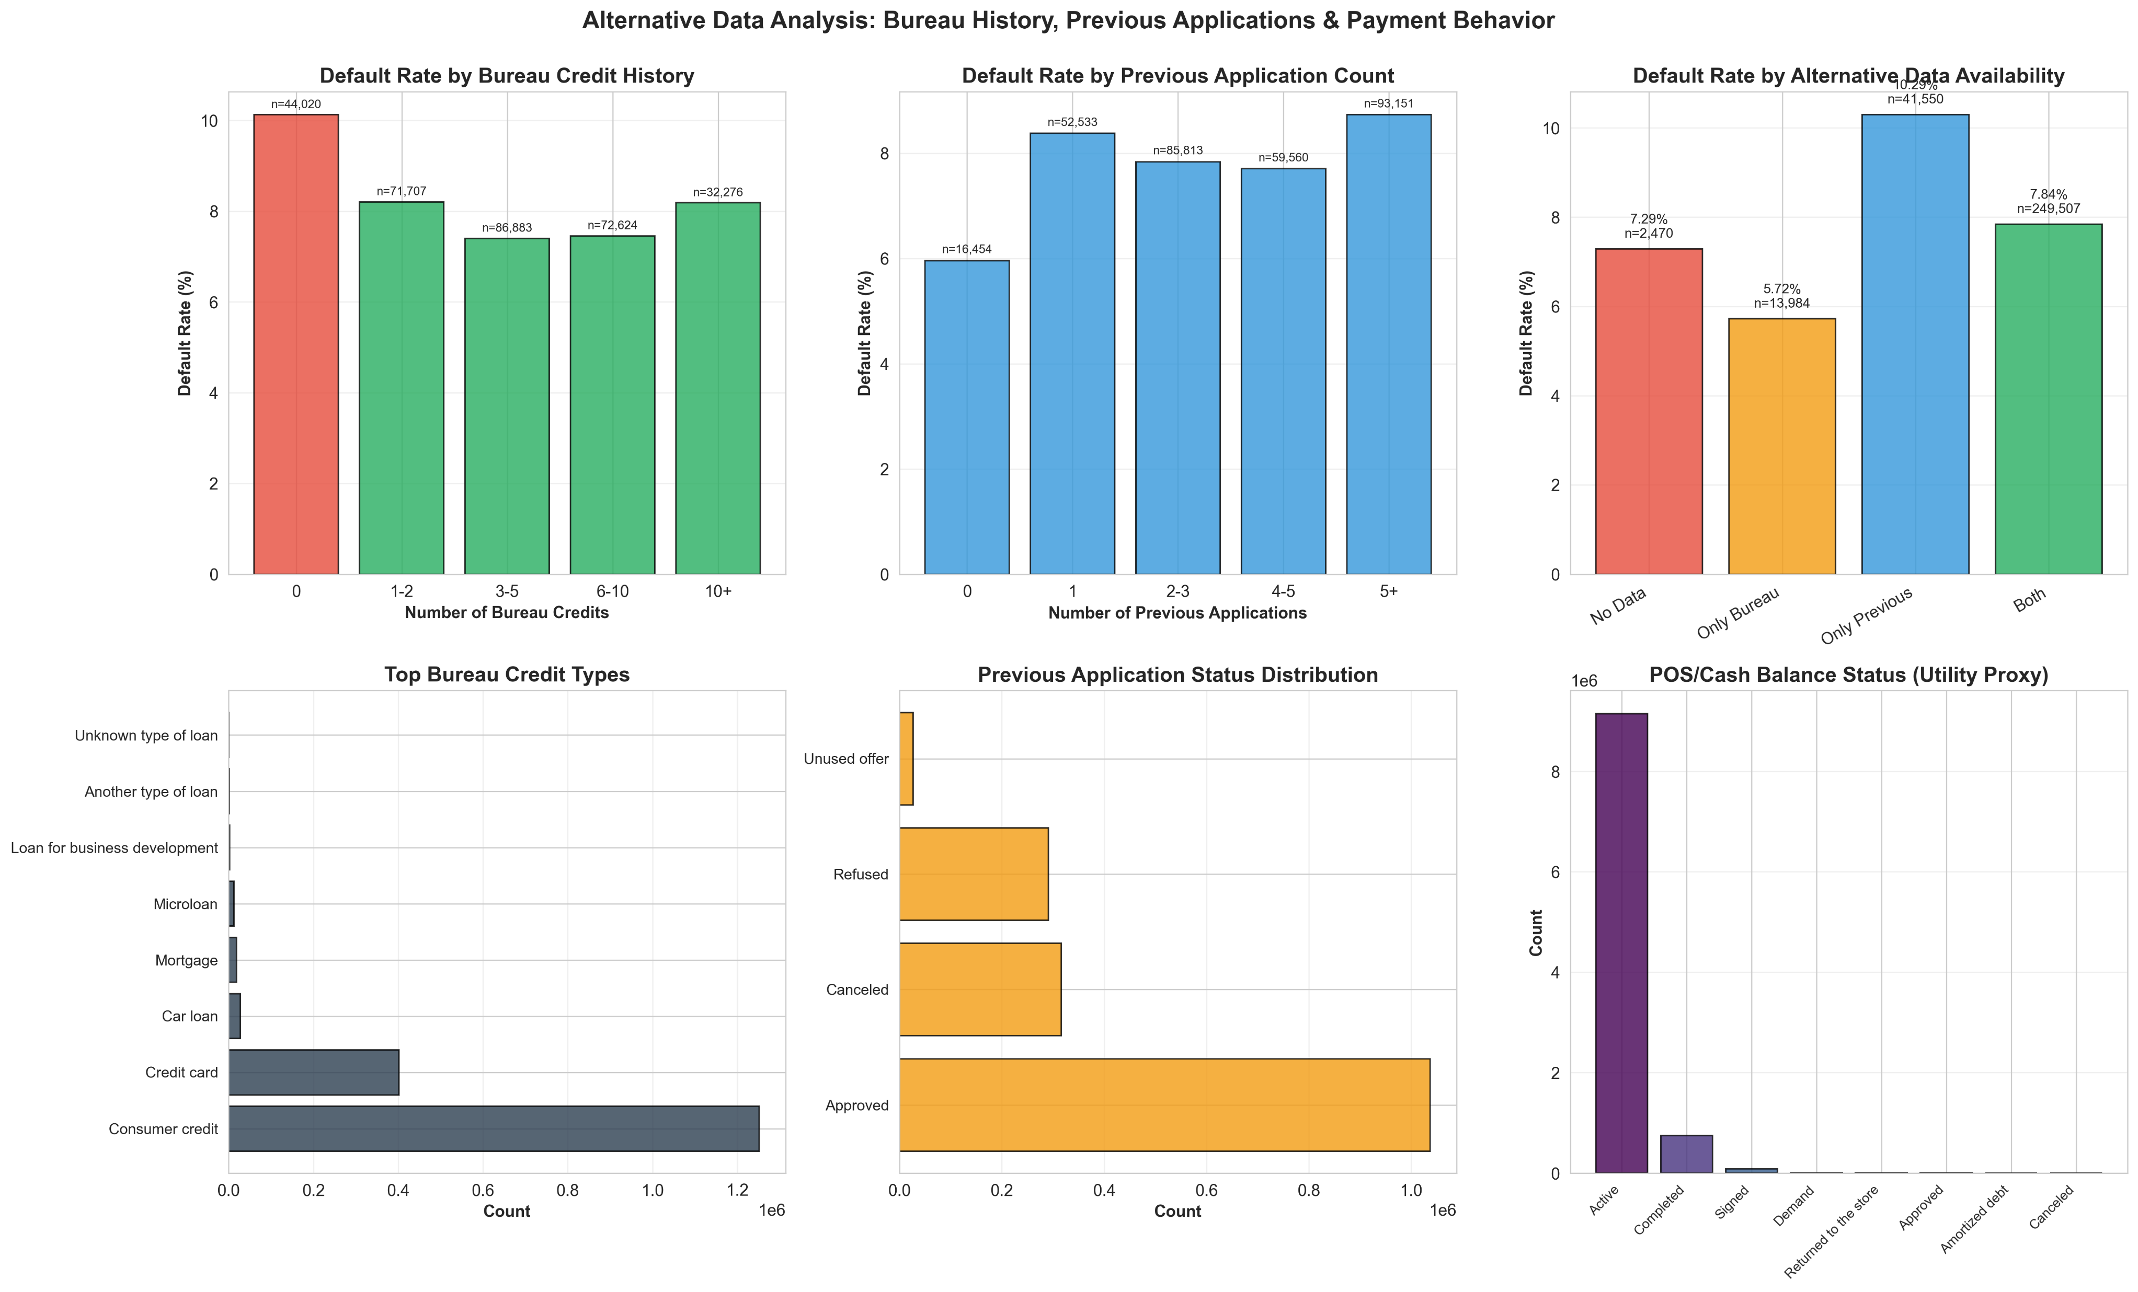
Inference 1 – Alternative Data Works

Slide 7
Inference 2 – Payment Behavior is Primary
The Challenge: we couldn’t get utility payment data – so we asked a smarter question
“Can everyday payment behavior tell the same story?”
What we Did: We analyzed over 10 million POS and cash balance transactions to understand real payment behavior.
What Utility Bills Show
Monthly payment patterns
Payment timing behavior
Financial discipline
What POS/Cash Shows
Recurring transactions
Tracked month-by-month
Payment consistency
What we discovered:
68.4% of people pay early
23.1% pay on time
Only 8.4% pay late
Key Insight:
Most people already show financial discipline through everyday payments.
Consistent payment behavior can predict creditworthiness — even without traditional credit history.

Slide 8
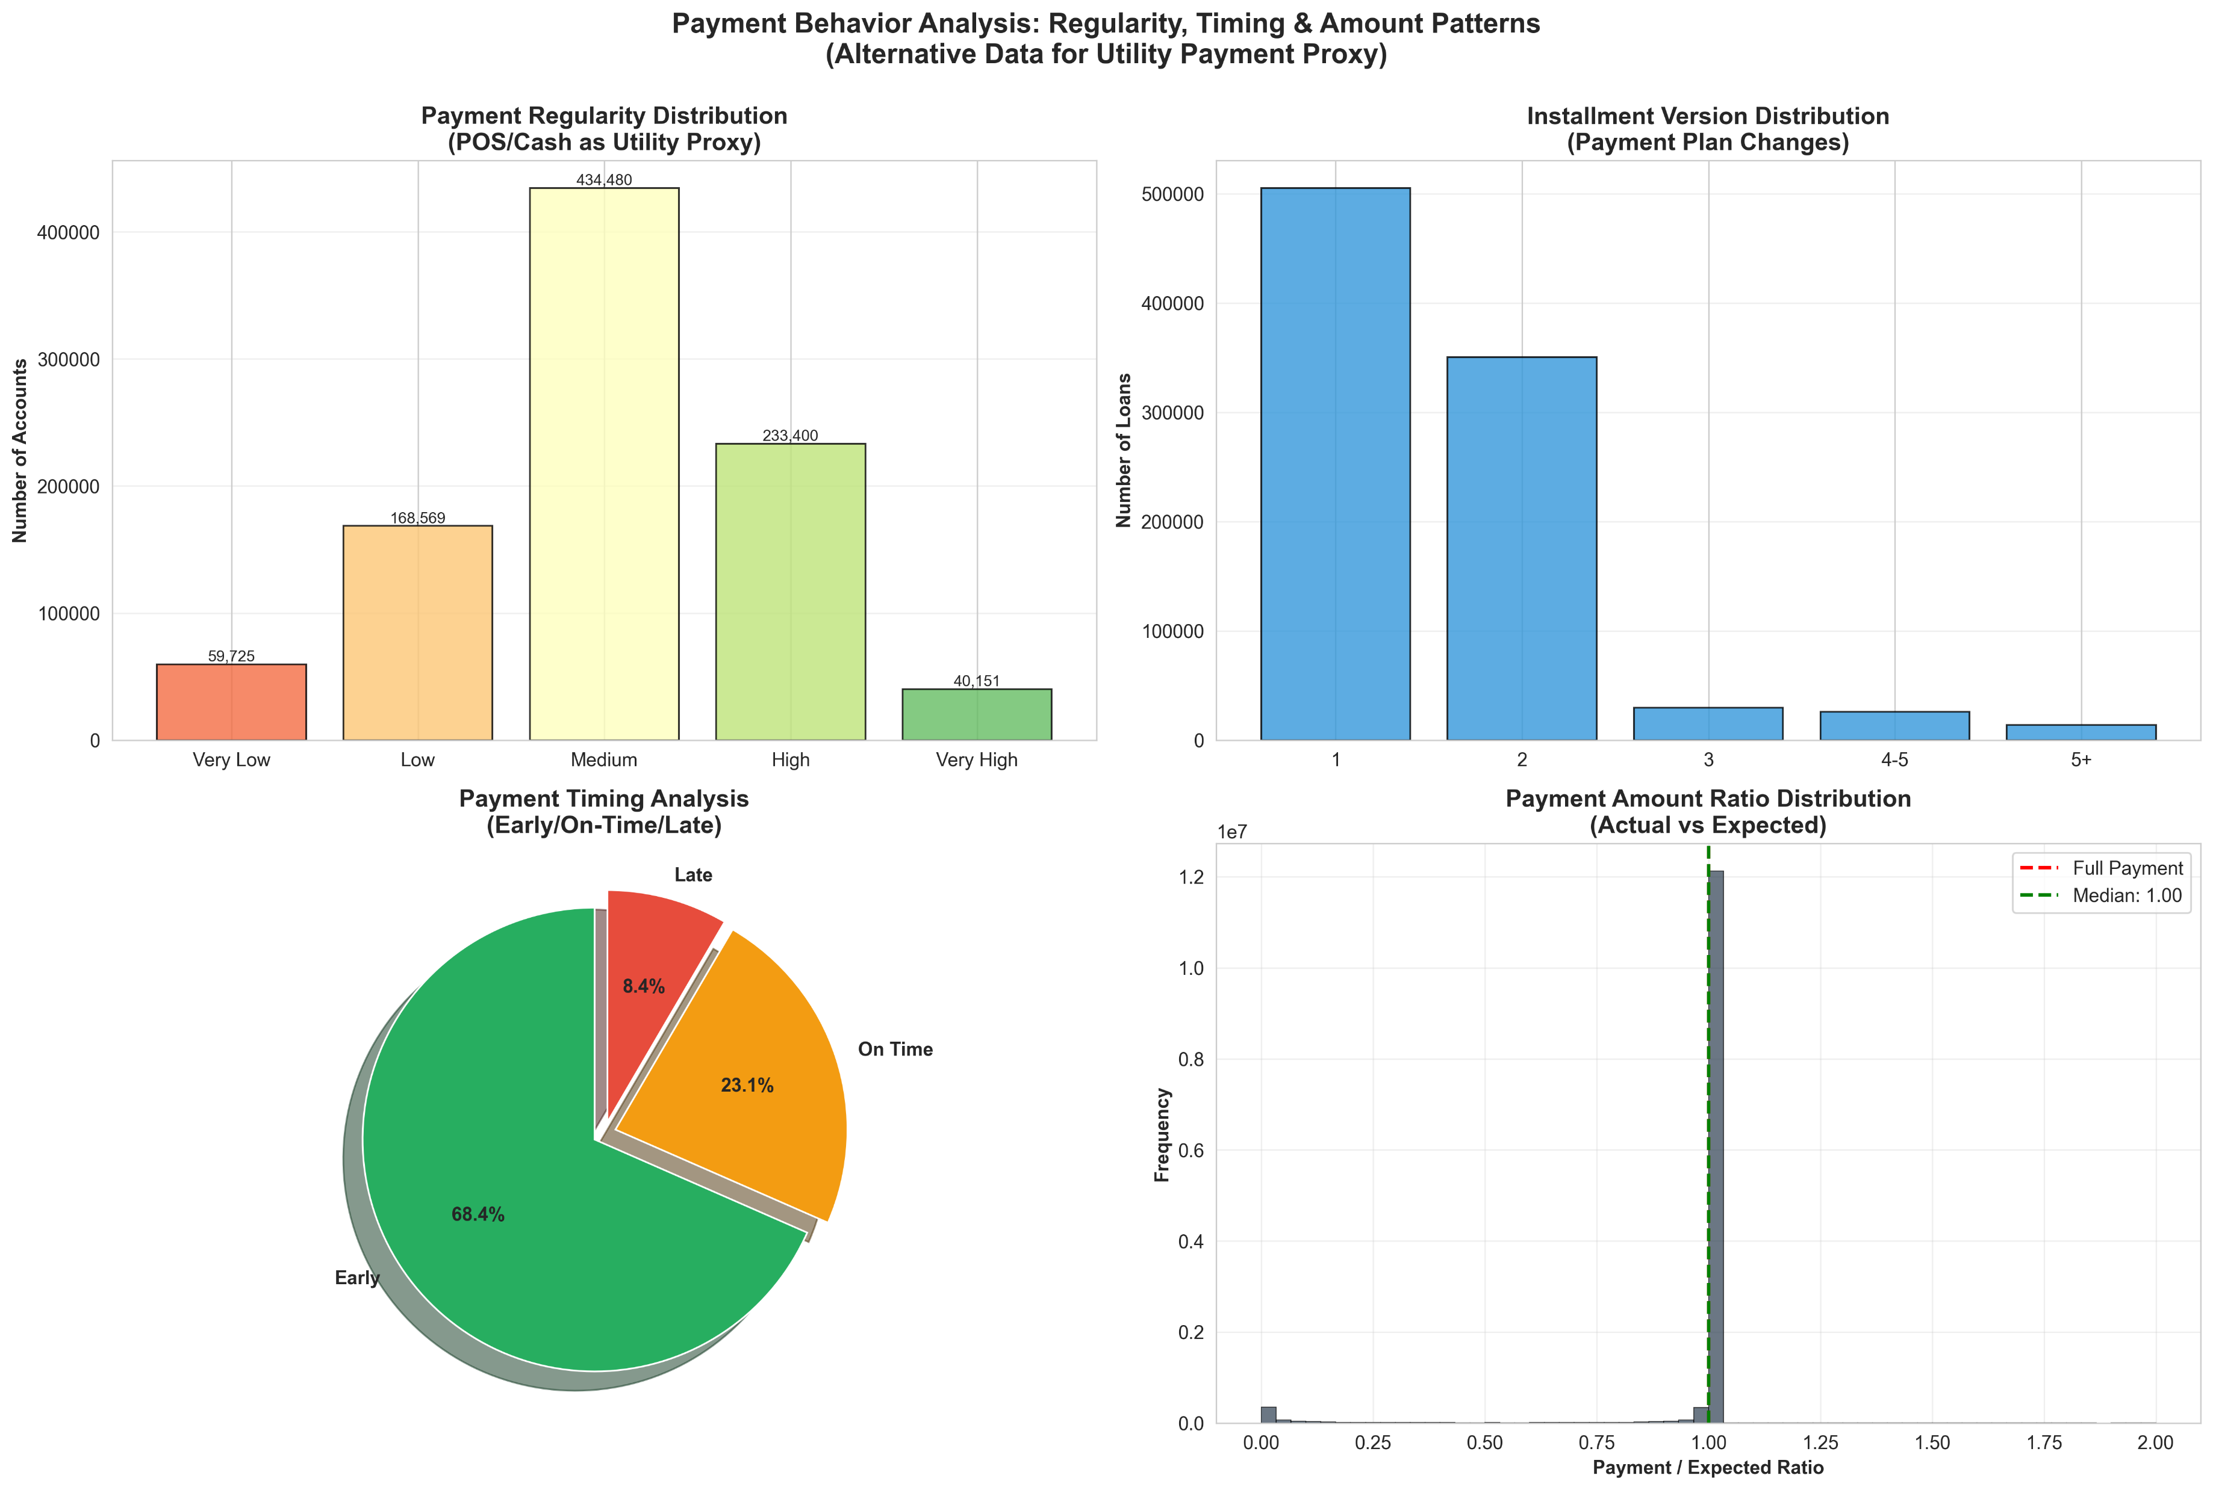
Inference 2 – Payment Behavior is Primary

Slide 9
Inference 3 – Top Predictors
The Rankings (What Correlates Most with Default):
Rank | Feature | Correlation | What Is It?
1 | EXT_SOURCE_3 | 0.179 | Alternative credit score
2 | EXT_SOURCE_2 | 0.160 | Alternative credit score
3 | EXT_SOURCE_1 | 0.155 | Alternative credit score
4 | AGE_YEARS | 0.078 | Demographic factor
5 | CREDIT_GOODS_RATIO | 0.069 | Financial behaviour
6 | REGION_RATING | 0.061 | Geographic context
7 | DAYS_LAST_PHONE_CHANGE | 0.055 | Behavioral stability
What the data shows:
• Reliable borrowers typically have higher EXT_SOURCE scores (0.5–0.7)
• Defaulters cluster at lower score ranges (0.2–0.4)
Our Strategy:
Instead of relying on one score, we combine many signals using machine learning to create a more accurate and fair credit assessment.

Slide 10
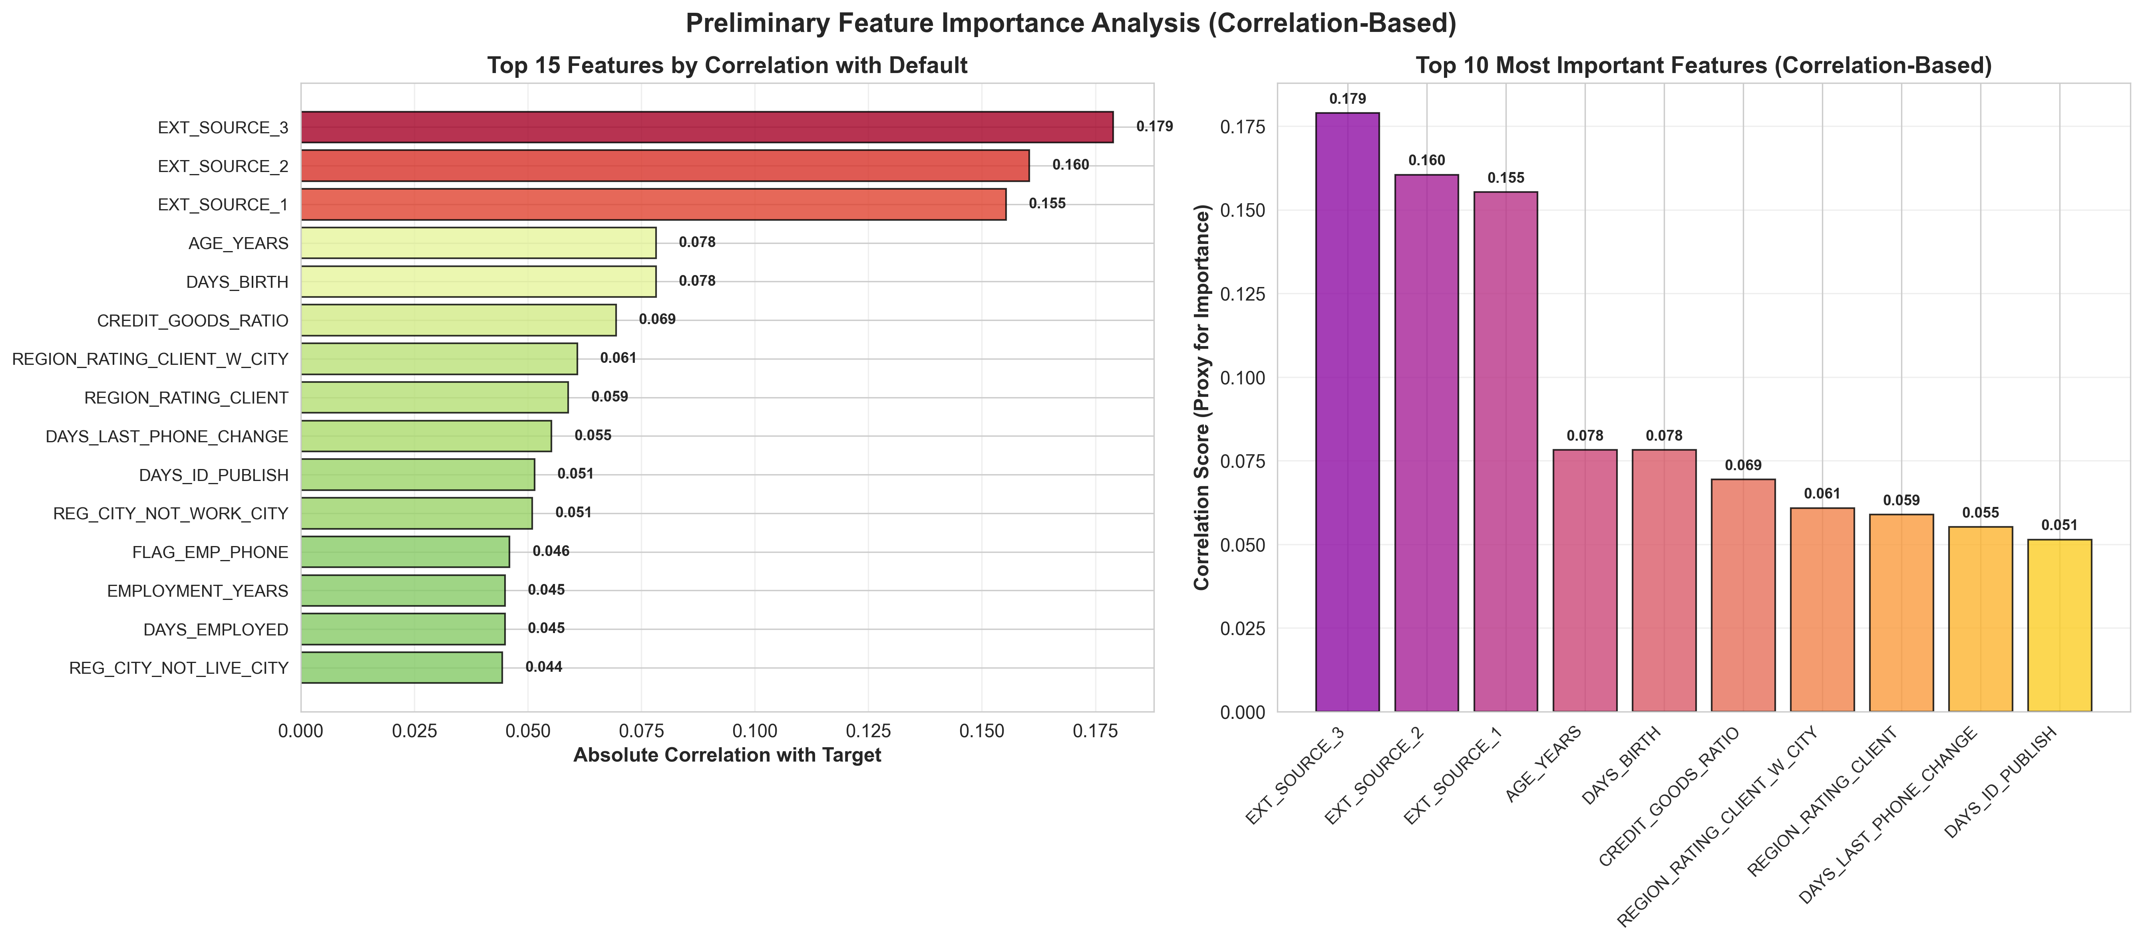
Inference 3 – Top Predictors

Slide 11
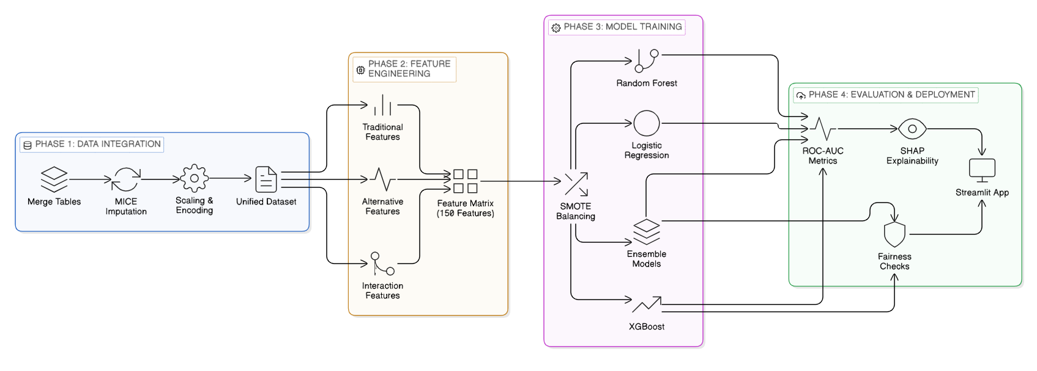
Methodology

Slide 12
Summary
What We've Shown You Today:
  The Challenge: 1.7B people excluded from financial services
  Our Solution: Alternative credit scoring using payment behavior, social data
  The Data: 307K applications + 57M alternative data records
  The Proof: Alternative data reduces default risk by 21%
  The Innovation: 10M payment records as utility proxy (68% pay early!)
  The Plan: 4-phase approach to deployed model in 4 weeks
Primary Statistics:
  8.07% default rate (manageable)
  21% risk reduction with alternative data
  68.4% early payment rate (strong discipline)
  0.179 top correlation (external alternative scores)
  ROC-AUC > 0.75 target for next week

